Slide 1
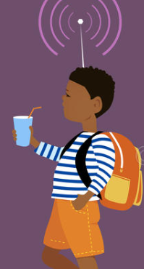
IoT Based Safety Gadget for Child Safety Monitoring & Notification
SUBMITTED TO
IBM Naalayathiran program

Slide 2
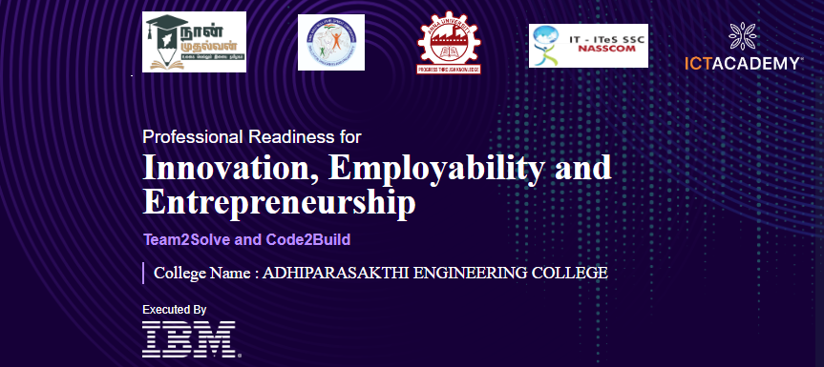
Team ID:PN2202TMID38645

Slide 3
IoT Based Safety Gadget for Child Safety Monitoring & Notification
Team ID:PN2202TMID38645
TEAM LEADER : PUSHPALATHA.K(420419106022)
TEAM MEMBERS:
J.MADHUVANTHI(420419106017)
E.ASHWINI (420419106002)
V.PREETHAA(420419106020)
M.LAVANYA(420419106701)

Slide 4
Project Overview
Basically, children cannot complain about abusements which they face in their daily life to their parents. They can’t even realize what actually happens to them at their age.
It is also difficult for parents to identify their children are being abused. Since to prevent children before being attacked, an autonomous real-time monitoring system is necessary for every child out there.
In this system, the collected values from every sensor like temperature sensor, pulse rate detection sensor, metal detection sensor, and the location value from GPS are used to detect the status of the child and alerts the respective guardians using GSM accordingly.

Slide 5
References
1. Kamat, Mr DK, Ms Pooja S. Ganorkar, and Mrs RA Jain. “Child activity Monitoring using Sensors.”International Journal of Engineering and Techniques 1.3 (2015): 129-133.
2. Saranya, J., and J. Selvakumar. “Implementation of children tracking system on android Mobile terminals.” Communications and Signal Processing (ICCSP), 2013 International Conference on. IEEE, 291
3. P. Wei, R. Guo, J. Zhang and Y. T. Zhang, “A new wristband wearable sensor Using adaptive reduction filter to reduce motion artifact”, Information Technology And Applications in Biomedicine 2008. ITAB 2008. International Conference on, pp. 278-281, May 2008

Slide 6
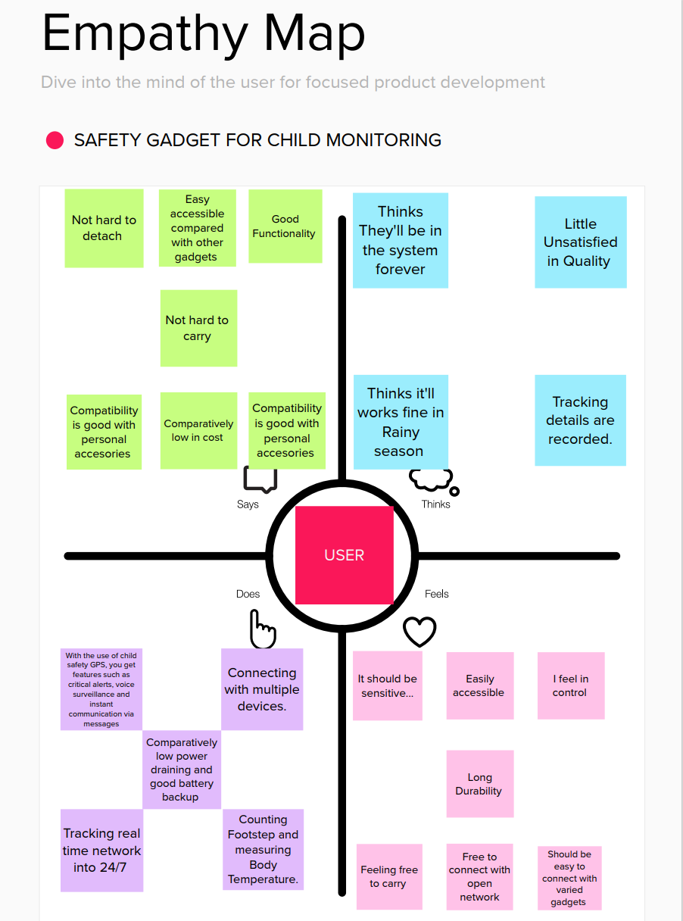
Empathy Map Canvas

Slide 7
Ideation & Brainstroming
IOT-based wearable device for the Safety a girl children
To develop awearable device for the safety and protection of women and girls. This objective is achieved by the analysis of physiological signal sincon junction with body position,
The physiological signals that are analyzed are galvanic skin resistance and body temperature. Body position is determined by acquiring raw accelerometer data from a triple axis accelerometer. Acquisition of raw data is then followed by activity recognition which is a process of employing as pecialized machine learning algorithm.
Real-time monitoring of data is achieved by wirelessly sending sensor data to an open source Cloud Platform Analysis of the data is done on MATLAB simultaneously. This device is programmed to continuously monitor the subject's parameters and take action when any dangerous situation presents itself. It does so by detecting the change in the monitored signals, following which appropriate action is taken by means of sending notifications alerts to designated individuals..
Smart Intelligent System for Child Security
A portable device which will have a pressure switch. As soon as an assailant is about to attack the person or when the person senses any in security from a stranger, he/she can then put pressure on the device by squeezing or compressing it .
Instantly the pressure sensor senses this pressure and a conventional SMS, with the victim's location will be sent to their parents/guardian cellphone numbers stored in the device while purchasing it, followed by a call. If the call sun answered for a prolonged time ,a call will be redirected to the police and the same message will be sent.
Additionally, if the person crosses some are a which is usually not accessed by the person then a message with the real-time location is sent to the parent/guardian's phone via conventional SMS.

Slide 8
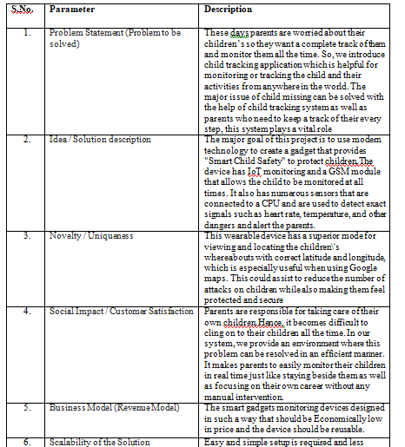
Proposed Solution

Slide 9
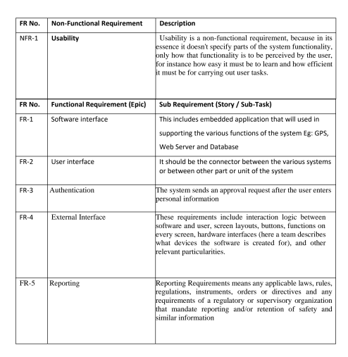
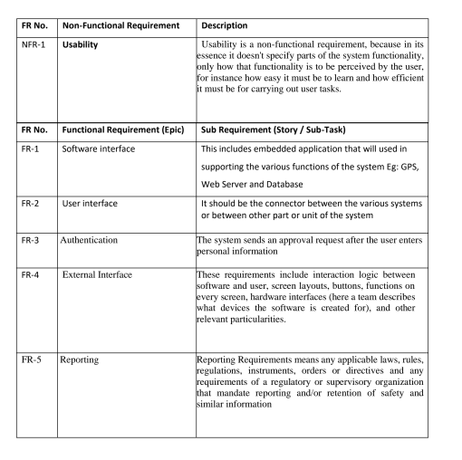
REQUIREMENT ANALYSIS.
Functional requirement
Non-functional requirements

Slide 10
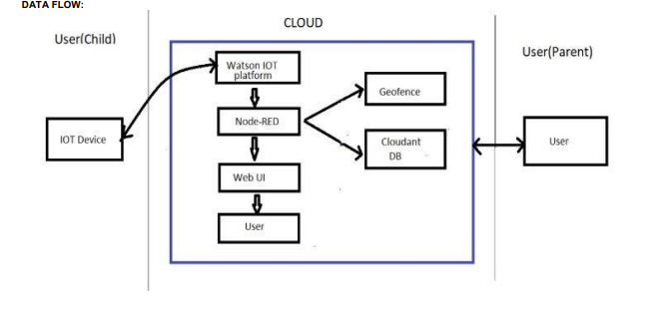
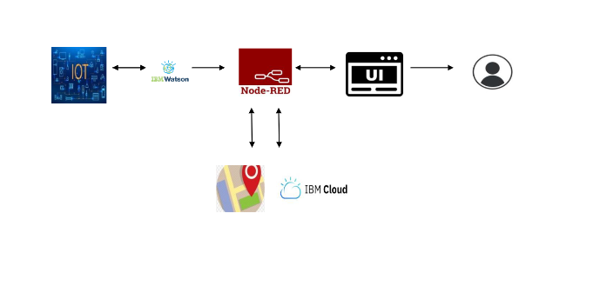
PROJECT DESIGN
Data Flow Diagrams
Solution & Technical Architecture

Slide 11
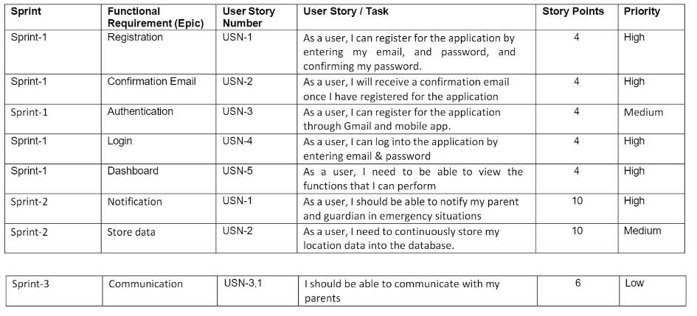
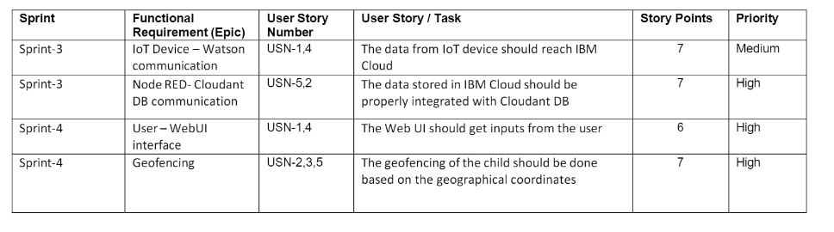
Sprint Delivery Scheduling

Slide 12
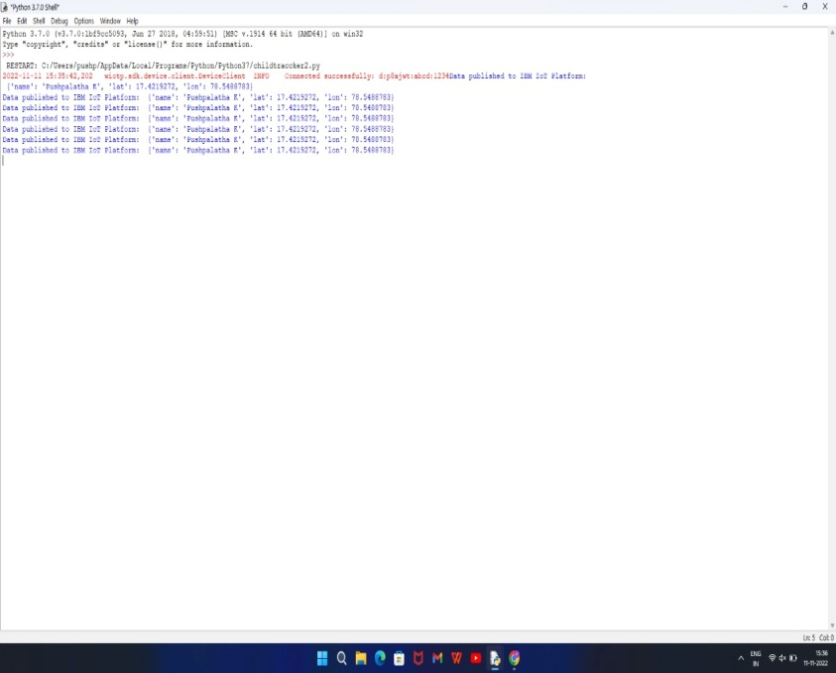
CODING & SOLUTIONING
Python code:
import time
import wiotp.sdk.application
myConfig = {
"identity" : {
"orgId" : "p8ajwt",
"typeId": "abcd",
"deviceId":"1234",
},
"auth": {
"token": "12345678"
}
}
client = wiotp.sdk.device.DeviceClient(config = myConfig, logHandlers = None) client.connect()
while True:
name = "Pushpalatha K"
#in area location latitude = 17.4219272
longitude = 78.5488783
#out area location
#latitude = 17.4219272
#longitude = 78.5488783
myData = {"name":name, "lat":latitude, "lon": longitude}
client.publishEvent(eventId = "status", msgFormat = "json", data = myData, qos = 0,
onPublish =None)
print("Data published to IBM IoT Platform: ", myData)
time.sleep(5)
client.disconnect()

Slide 13
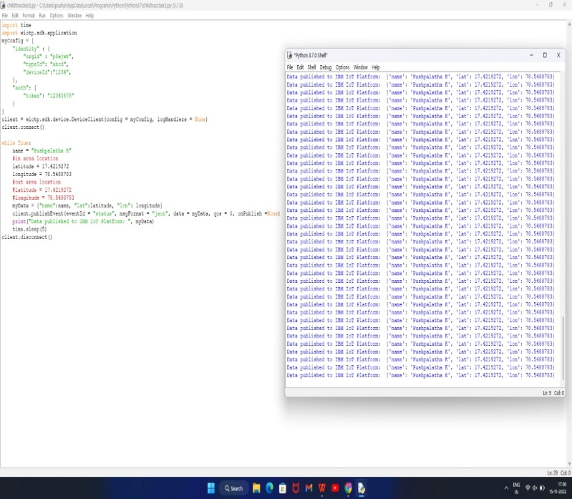
Modified Version of Code according to main project:
import json
import wiotp.sdk.device
import time
myConfig={
"identity":{
"orgId": "p8ajwt", "typeid": "abcd",
"deviceId": "1234"
},
"auth": {
"token": "12345678"
}
}
client = wiotp.sdk.device.DeviceClient (config=myConfig, logHandlers=None)
client.connect()
while True:
name= "Pushpalatha K"
#in area location
latitude-=17.4219272
Longitude= 78.5488783
#out area location
#latitude = 17.4219272
#longitude =70.5488783
myData = {'name':name, 'lat':latitude, 'lon': longitude}
client.publishEvent (eventId="Status", msgFormat="json", data=myData,
qos=0, onPublish=None)
print ("Data published to IBM IoT platform: ",myData)
time.sleep(5)
client.disconnect()

Slide 14
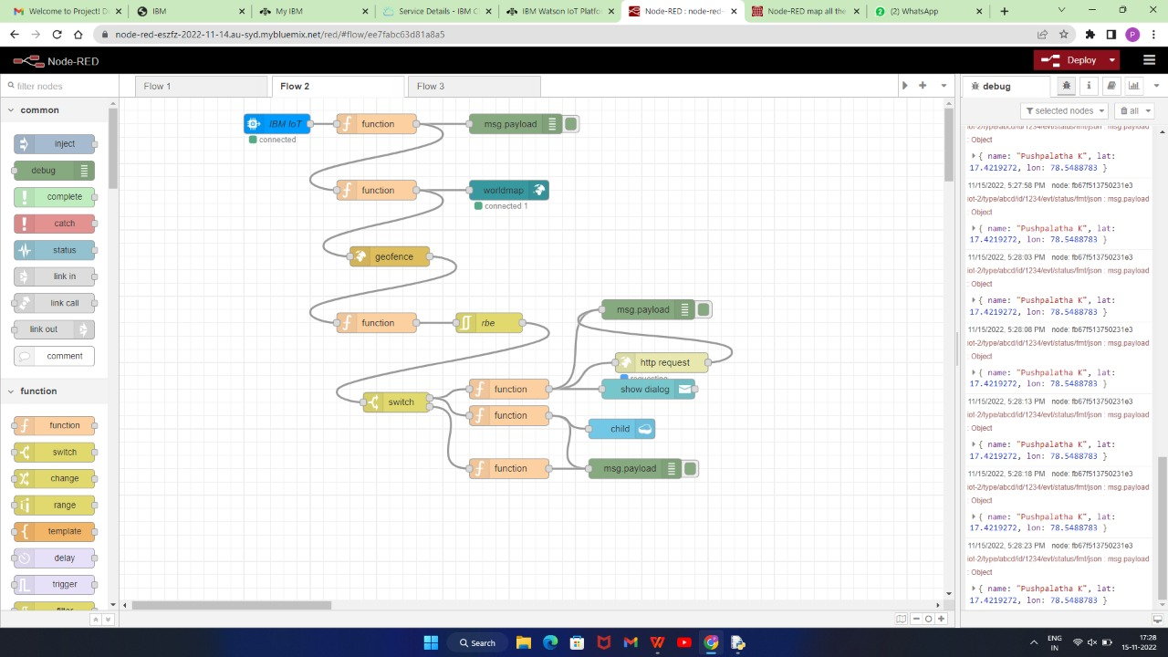
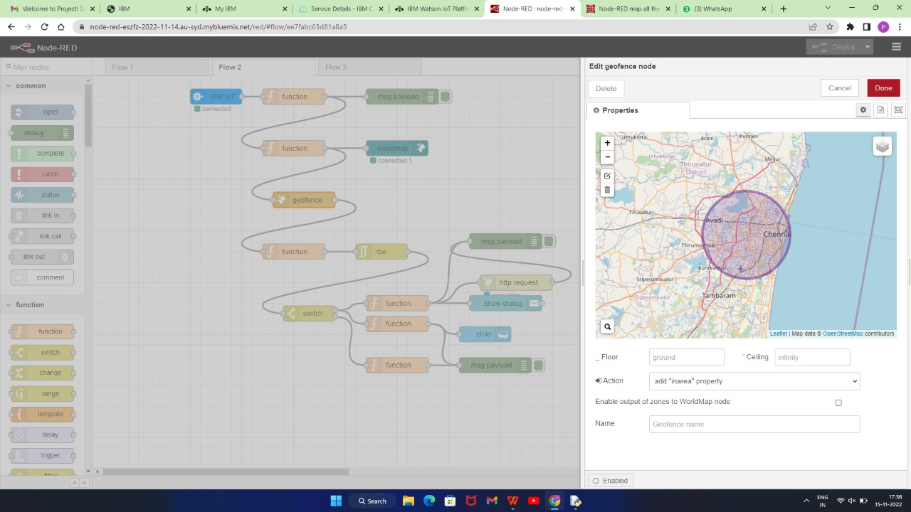
Database Schema
● Opened a Node-RED project
●Create TheGeopference

Slide 15
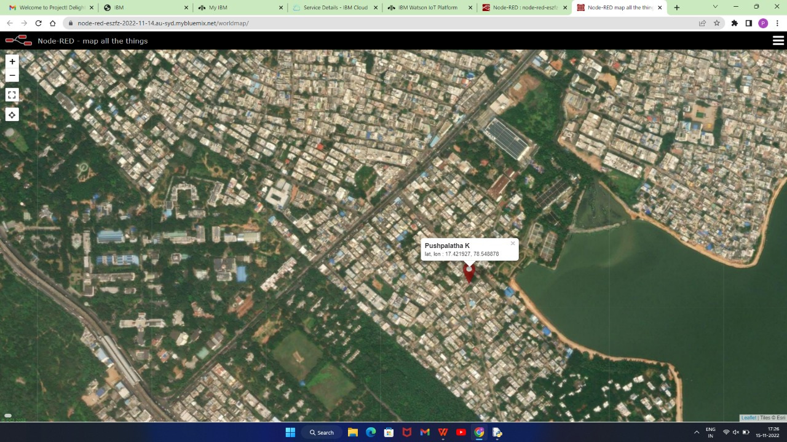
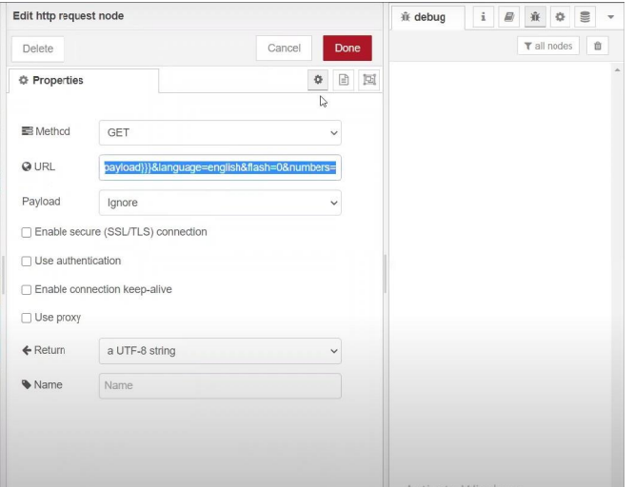
Editing the HTTP Request URL
● Located the child

Slide 16
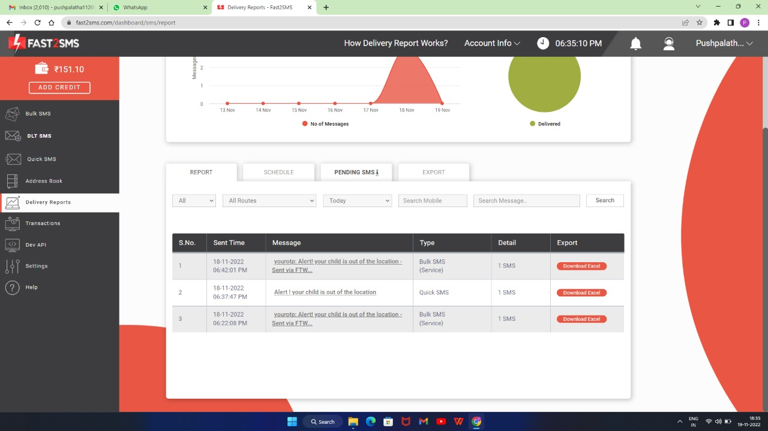
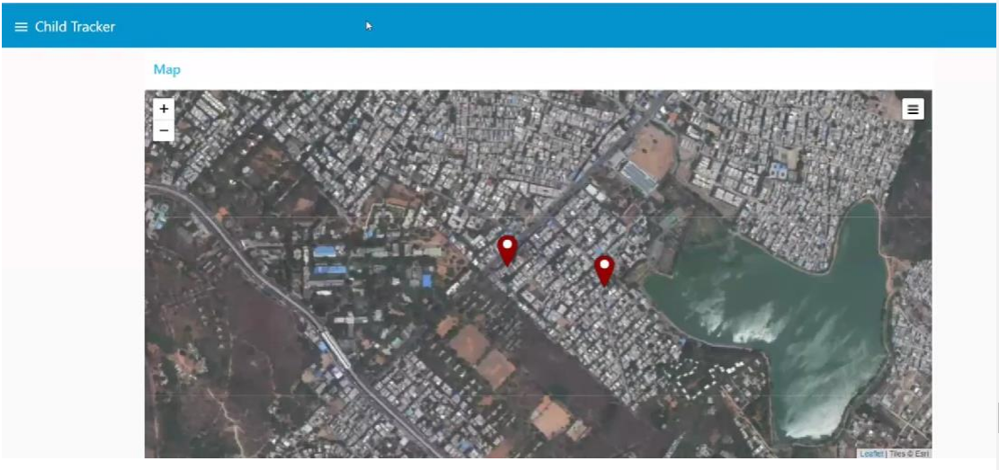
Fast to SMS
After running the script, the web UI shows “Person is not in the particular area

Slide 17
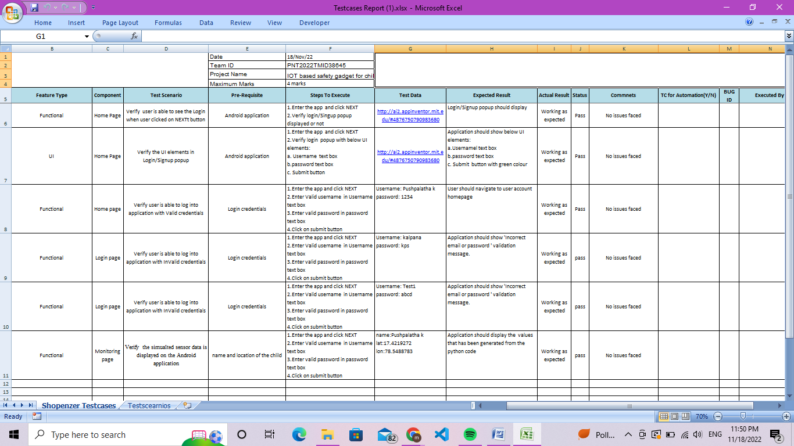
TESTING

Slide 18
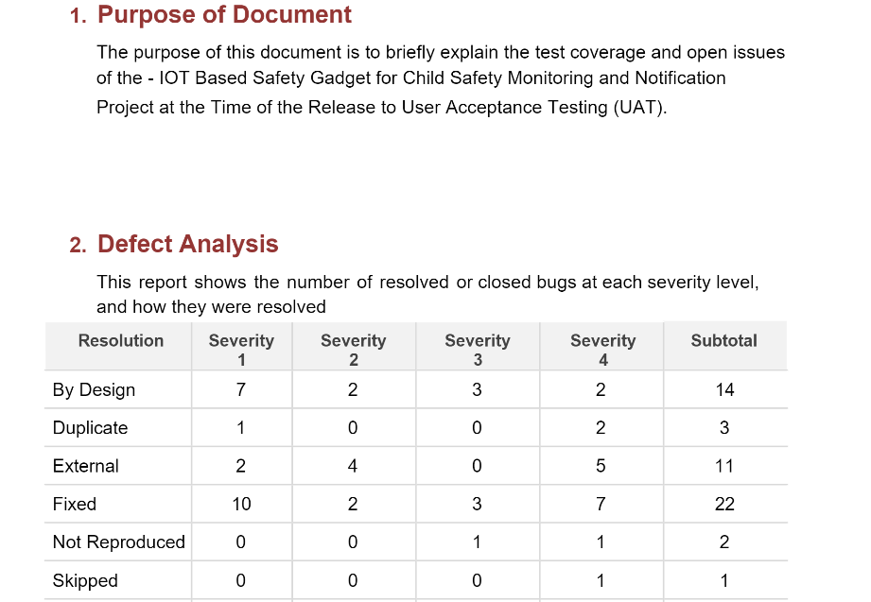
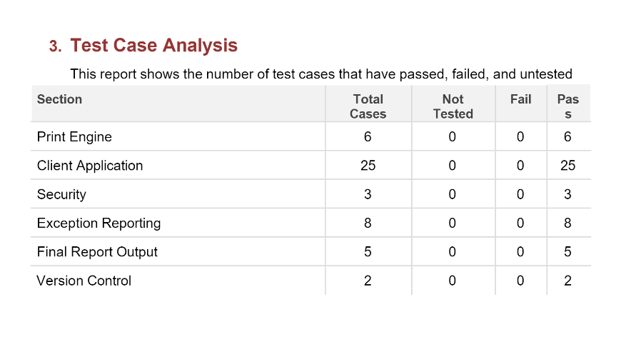
User Acceptance Testing

Slide 19
9.RESULTS
Performance Metrics
Use performance monitoring to know the velocity of data records processed by your deployment.
You enable performance monitoring when you select the deployment to be tracked and monitored.Performance metrics are calculated based on the following information:
scoring payload data
For proper monitoring purpose, log in every scoring request in Watson OpenScale as well. Payload data logging is automated for IBM Watson Machine Learning engines.
For other machine learning engines, the payload data can be provided either by using the Python client or the REST API. Performance monitoring does not create any additional scoring requests on the monitored deployment.

Slide 20
Advantages
In our system, we provide an environment where this problem can be resolved in an efficient manner. It makes parents to easily monitor their children in real time just like staying beside them as well as focusing on their own career without any manual intervention.
Disadvantages:
Hackers may gain access to the system and steal personal information. Since we add so many devices to the internet, there is a risk that our information as it can be misused.
They rely heavily on the internet and are unable to function effectively without it.
With the complexity of systems, there are many ways for them to fail.
We lose control of our lives—our lives will be fully controlled and reliant on technology.
Overuse of the Internet and technology makes people unintelligent because they rely on smart devices instead of doing physical work, causing them to become lazy.
Unskilled workers are at a high risk of losing their jobs, which could lead to unemployment. Smart surveillance cameras, robots, smart ironing systems, smart washing machines, and other facilities are replacing security guards, maids, ironmen, and dry-cleaning services etc.
It is very difficult to plan, build, manage, and enable a broad technology to IoT framework.
Deploying IoT devices is very costly and time-consuming.

Slide 21
CONCLUSION
This research demonstrates Smart IoT device for child safety and tracking helping the parents to locate and monitor their children.
If any abnormal values are read by the sensor then an SMS is sent to the parents mobile and an MMS indicating an image captured by the serial camera is also sent.
The future scope of the work is to implement the IoT device which ensures the complete solution for child safety problems.

Slide 22
FUTURE SCOPE
This research demonstrates Smart IoT device for child safety and tracking, to help the parents to locate and monitor their children.
If any abnormal readings are detected by the sensor, then an SMS and phone call is triggered to the parents mobile. Also ,updated to the parental app through the cloud.
The system is equipped with GSM and GPS modules for sending and receiving call, SMS between safety gadget and parental phone.
The system also consists of Wi-Fi module used to implement IoT and send all the monitored parameters to the cloud for android app monitoring on parental phone.
Panic alert system is used during panic situations alerts are sent to the parental phone, seeking for help also the alert parameters are updated to the cloud.
Boundary monitoring system is implemented on safety gadget with the help of BEACON technology, as soon as the safety gadget moves far away from the BLE listener gadget an alert is provided to itself.
Future Scope of Work This system can be further enhanced by installation of mini camera
inside smart gadget for better security so that live footage can be seen on parental phone during panic situations.
The system can be modified by installation of small solar panels for charging the battery of smart gadget to gain maximum battery backup.

Slide 23
Github & Design
https://github.com/IBM-EPBL/IBM-Project-14089-1659540380

Slide 24
THANK YOU

